Slide 1
ME 370
Design Lab 3 Template
[Team 48]
[Sebastian, Daniel, Shihong Yuan, Liangbing Zhao]

Slide 2
Video Walkthrough
Office Materials
Virtual Reality Simulation
Storyboard
Powerpoint Animations
Computer-Aided Mathematical Modeling
Manual Mathematical Model
Manual Simulation
Distorting an Existing Design
Sketch
Craft Materials
Early Working Version
CAD Assembly Model
Wireframe
3D Printed Model
CAD Model
Breadboard Circuit
Engineering Drawing
Custom PCB
Notes:
Prototype Method Categorization (Question 1)
For each prototyping method on the list, discuss as a group where on the fidelity spectrum it belongs to (from low- to high-) and where on the purpose spectrum it belongs (from purely-for-experience to purely-for-function) relative to the other methods. Place the post-its onto the 2x2 based on what you decide. IMPORTANT NOTE: This activity is subjective; don’t worry about getting the “right” answer, and focus more on being able to justify your choices.
Definitions can be found on the lab manual.

Slide 3
Were any of the prototypes on the list surprising to you? Pick 2 or 3 and explain why
Distorting an Existing Design
[Insert Prototype Name #1]
Virtual Reality Simulation
Manual Simulation
This one was surprising because when I think of prototyping I typically think of a new product
However it makes sense as if there is already a design it makes sense to build off of it
A virtual reality simulation is something very high fidelity when creating a prototype to convey the experience
I would think that going straight to a video walkthrough may be more helpful but that would depend on the design being prototyped
Manual simulation helps us actually operate certain mechanical structure, and we can feel the friction existing in this mechanical structure and the driving force required.
This will also help us determine the number of transmission structures and the ratio of the number of gear teeth
Notes:
Prototype Method Categorization Part II (Question 2)

Slide 4
Which prototypes on the list prompted the most discussion from your group on where to place them? Pick 2 or 3 and describe how your group came to your decision
[Insert Prototype Name #1]
Manual Mathematical Model
Engineering Drawing
[Insert Prototype Name #2]
[Insert Prototype Name #3]
Video Walkthrough
We werent sure where to put this between experience and function
We decided it was more experience because its used to prove if something will work, it doesnt dictate how you will make it work
We werent sure what level of fidelity an engineering drawing was
We decided it was pretty high fidelity because it typically includes dimensions/tolerances which would be something that you decide late in the design process
We struggled if this was experience or function
We decided on experience because it would help show someone how it works and what it looks like, it wouldnt decide how it functions
Notes:
Prototype Method Categorization Part III (Question 3)

Slide 5
Design Variables | Design Constraints
Speed of the robot Gear ratios Materials used for construction Payload being transported | Budget Time Spatial footprint of design Payload weight criteria Manufacturing methods allowed Driving mechanism (hand-crank)
Notes:
Prototype Creation Prompt Part I (Question 1 & 2)
Using Project 1 info on Canvas, complete each of the following fields with your group:
List with your group what specific constraints and variables might be present in this challenge.
Design Variables - the parameters of the design which can be changed to meet the requirements
Design Constraints - a restriction of the design which does not add capability but effects the implementation. Examples of these include the “-itilies” such as manufacturability, assemblability, reliability, availability, sustainability, etc.
Identify at least two

Slide 6
Identify at least 3 questions about the design for your selected destination that your team would like to answer using prototypes
What dispensing mechanism are we using? | How is the payload going to be stored in the robot? | How do we connect different transmission mechanisms?
3D Printing | Craft/Office Materials | Gears and transmission
Components we will need to buy/design What mechanism we will use (gears,linkages,etc.) What movements we want to have It will allow us to make a pretty detailed prototype but also change it up pretty easily | Appearance Relative scale of robot | Speed ​​ratio of different turntables Restraint device We can use this prototype to demonstrate our most basic transmission process, how to combine two devices together.
Notes:
Prototype Method Categorization (Question 3 & 4)
After defining questions: Describe an idea for a potential prototype or partial prototype for each question in Q3. At this point, it may be useful to share a part of an idea you generated for the prelab. Feel free to be creative - you don’t have to limit yourself to only what you think you could build! In a perfect world, how would you answer each of these questions?

Slide 7
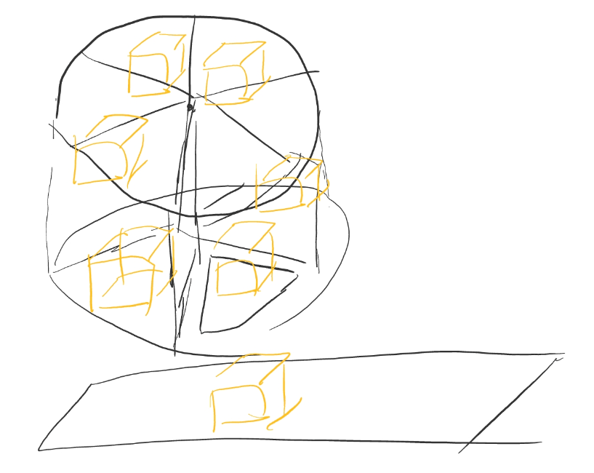
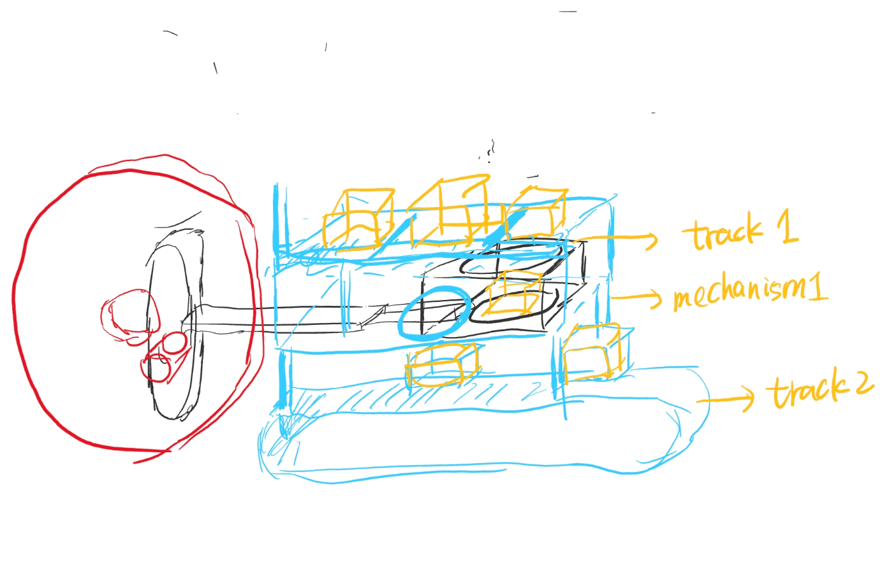
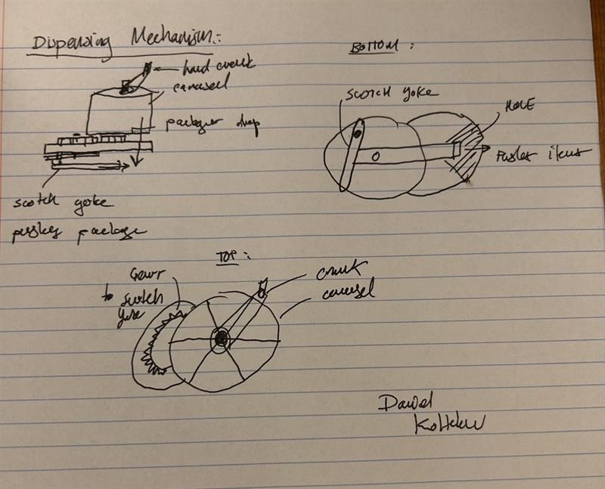
As a team select two of your prototype ideas and sketch them
Question it answers: What dispensing mechanism are we using? | Question it answers: How do we connect different transmission mechanisms?
Notes:
Prototype Method Categorization (Question 5)

Slide 8
Based on the previous sketches answer the following questions
Question it answers: What dispensing mechanism are we using? Is there any other useful information you can get from this prototype? What other prototype(s) would you like to create to fill gaps in your knowledge? Would you change which method you picked? Why or why not? This prototype rotates to push objects from each area into the hole, allowing them to fall. We might design a multi-layered turntable to store more objects, addressing the limited number of objects we can store. We won't change our approach, as the turntable is easier to integrate with gears and facilitates the movement of the cargo cart in Project 2. | Question it answers:How do we connect different transmission mechanisms? Is there any other useful information you can get from this prototype? What other prototype(s) would you like to create to fill gaps in your knowledge? Would you change which method you picked? Why or why not? Our prototype's transmission is achieved through rotation. The regular rotation of the turntable realizes the regular sliding of the card slot. We will create a gear-link prototype to complete the concept. We will not change our connection method, using gears with different numbers of teeth and multiple gears.
Notes:
Prototype Method Categorization (Question 6)

Slide 9
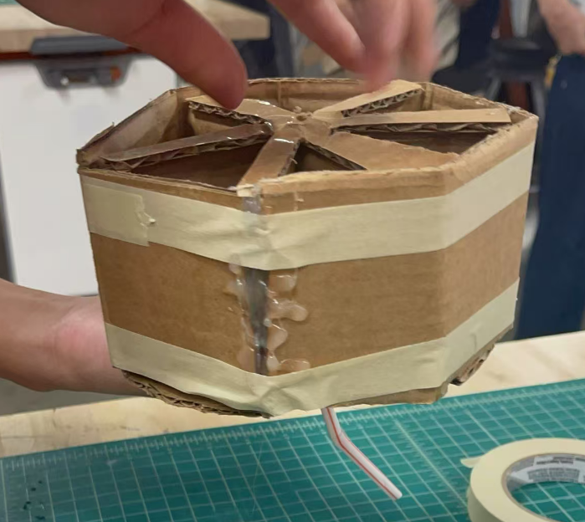
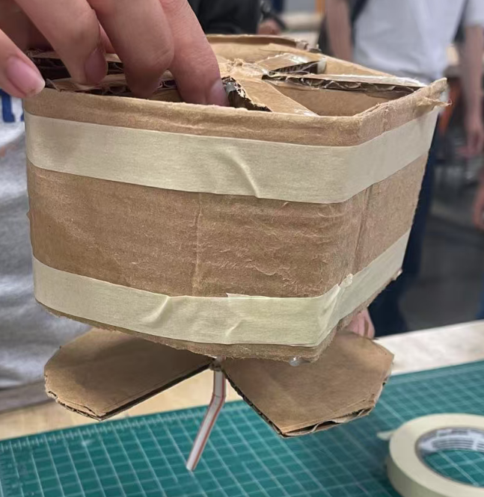
As a team build two prototypes. Remember the question you’re aiming to answer with this prototype; it could be as simple as trying to figure out what form or shape the design concept should take, or it can be as specific as honing in on a specific element of the design and simulating the experience or function of it.
The goal is to show how we drop. The key structure of our prototype is to make objects fall by rotating them. We use a circular shape and make each grid hold objects.
Note: The course instructors expect you will continue to work on your prototypes for D4, and will have a complete or function prototype to present.
Notes:
Physical Prototype Building and Analysis (Question 1)

Slide 10
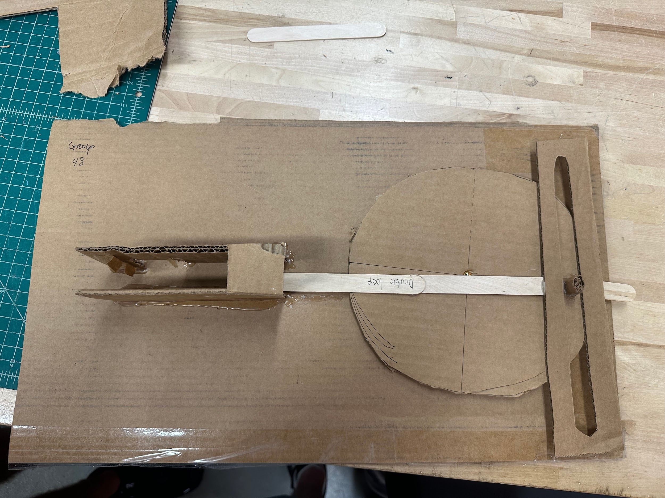
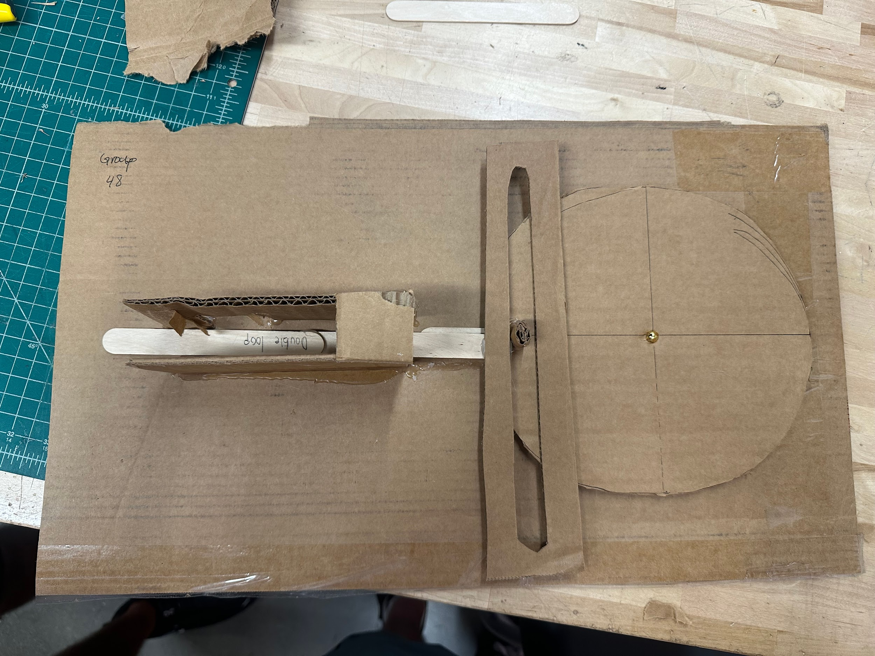
As a team build two prototypes. Remember the question you’re aiming to answer with this prototype; it could be as simple as trying to figure out what form or shape the design concept should take, or it can be as specific as honing in on a specific element of the design and simulating the experience or function of it.
The goal of this prototype is to get a feel for how the scotch-yoke mechanism will work. The part on the left is where the carousel (prototype 1) will drop the packages into. Once dropped they will be pushed out by the scotch-yoke.
Note: The course instructors expect you will continue to work on your prototypes for D4, and will have a complete or function prototype to present.
Notes:
Physical Prototype Building and Analysis (Question 1 cont.)

Slide 11
Answer the following discussion questions:
What were you able to discover/communicate with these prototypes?
We were able to get an idea of the real-life scale of our design. We were also able to grasp the functionality of our dispensing mechanism, and thus improve issues we are encountering with excessive friction.
If you had more time and resources, what would be the next prototype to build?
The next prototype iteration would involve more 3D printed components as that is a material we believe a bulk of our final design will include. We also want to look into making the mechanism smaller so it fits the shoebox spatial constraint.
Notes:
Physical Prototype Building and Analysis (Question 2 & 3)

Slide 12
Post lab:
Your post lab submission will be a TEAM submission
Ensure that your post lab has the following:
Part I
  Your group’s 2x2 with all post-its
  Your responses to the 2 discussion questions in Part I
Part II
  Your identified design constraints, variables and unanswered questions
  Descriptions of at least 3 prototype ideas, one for each question
  Sketches of at least 2 prototype ideas per team
  Your responses to the 3 reflection questions in Part II.6
Part III
  Pictures of each of your team’s two low fidelity physical prototypes
  Your responses to the 2 discussion questions in Part III.2 and III.3
Note: As a team, you should start to work on a CAD or detailed engineering drawings as you work towards more complete prototypes (D4 & D5)
Note: The course instructors expect you will continue to work on your prototypes for D4, and will have a complete or function prototype to present.
Notes:
Post lab submission guidelines, also found on the lab manual

